Slide 1
A Comparison Architecture of AMD Ryzen 5 3600X And Intel Core-i5 9600K Literature Review
Submitted By : Rubyat Jesmin Shammi UG02-47-18-034 Khondkar Md. Mufrat Tasif UG02-47-18-044 Ahsanul Bari Rifat UG02-47-18-007

Slide 2
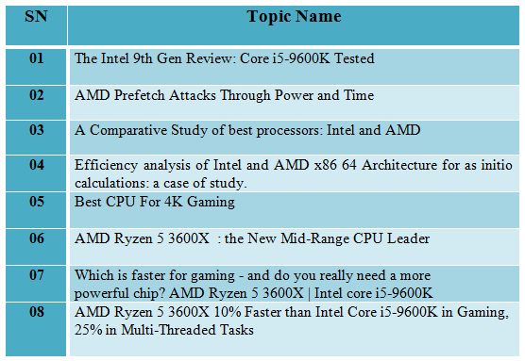
Existing scholarly work on the topic

Slide 3
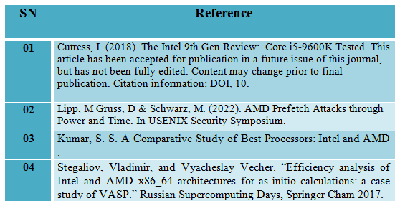
Existing scholarly work on the topic

Slide 4
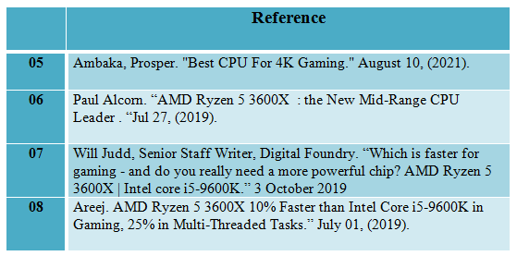
Existing scholarly work on the topic

Slide 5
Area of Focus and Contribution
Our areas of focus and contribution are :
Gaming Focus
For Workstation
Video Editing
Performance think about price
Heavy Software uses

Slide 6
Primary Finding

Slide 7
AMD Ryzen 5 3600X
The AMD Ryzen 5 3600x is a bags of performance in mid-range package and AM4 processor launched in 2019
AMD Ryzen 5 3600X Which is the Zen 2 micro architecture .
3MB L2 Cache , 32 MB L3 cache with operated 3.8 GHz .
It has a base clock speed of 3.8 GHz and can reach maximum boost clock speed of 4.4 GHz.
This processor has a 95W TDP ( Thermal Design Power) .
It has 6 cores and 12 threads and unlocked a wraith spire cooler.
AMD is building the Ryzen 5 3600x on a 7nm (nanometer) smaller semiconductor size.

Slide 8
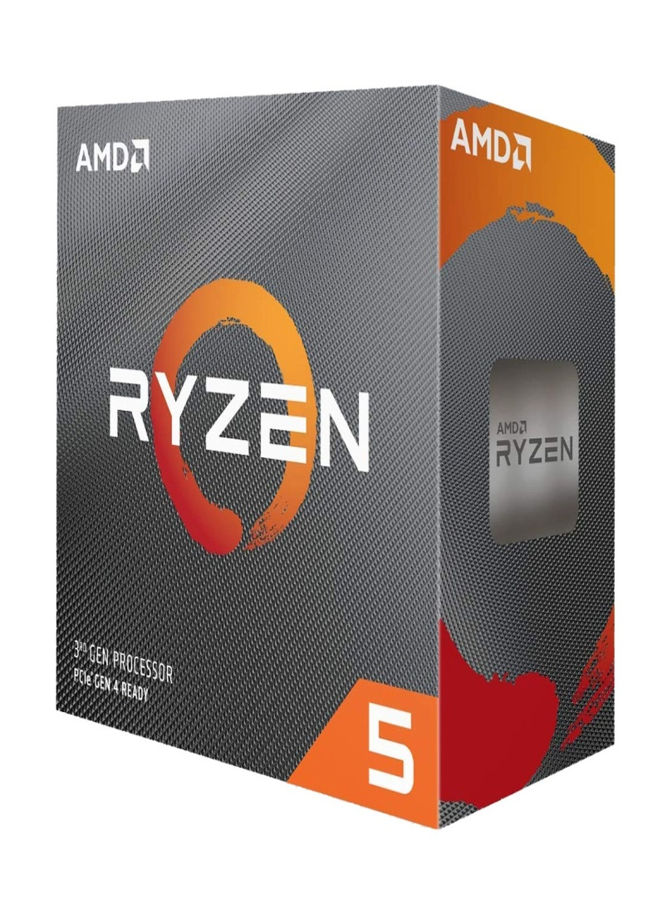
Intel Core i5-9600K
Highest supported memory is DDR4 3200 MHz with 2 memory channels.
The Ryzen 5 3600X doesn't have integrated graphics.
The latest price of AMD Ryzen 5 3600X Processor in Bangladesh is 21,500 Taka.

Slide 9
Intel Core i5-9600K
Intel Core i5-9600K 9th Generation is Socket LGA1151 Unlocked Desktop Processor launched in 2018.
The Core i5-9600K, which is based on the Coffee Lake micro architecture.
9 MB L3 cache with operated 3.7 GHz .
It has a base clock speed of 3.7 GHz and boost max speed of 4.6 GHz.
This processor has a 95W TDP ( Thermal Design Power) .
It has 6 cores and 6 threads and unlocked a wraith spire cooler.
Intel is building core i5-9600K on a 14nm (nanometer)
Highest supported memory is DDR4 2666 Mhz.

Slide 10
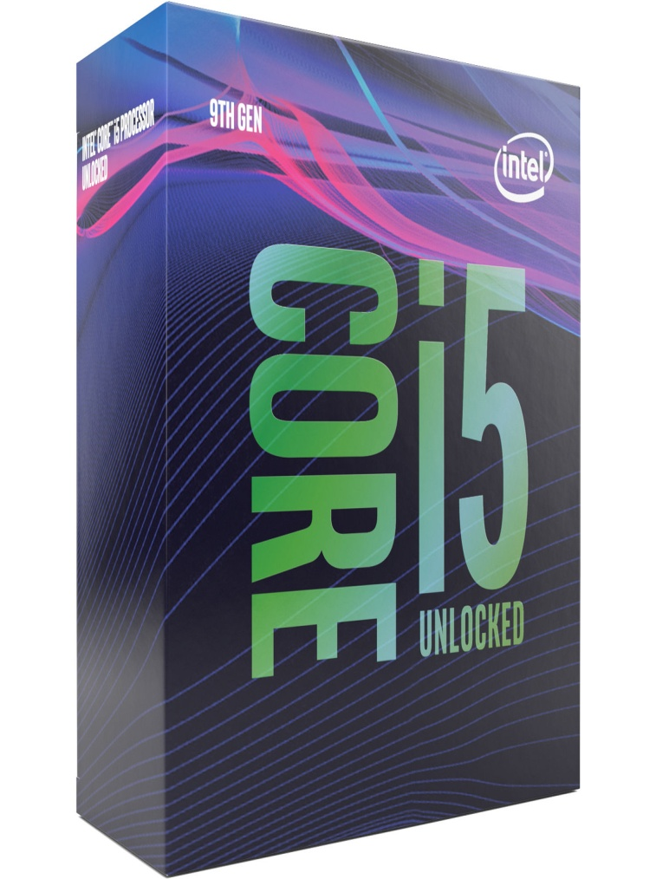
Intel Core i5-9600K
This processors Bus speed of 8 GT/s DMI3, it has integrated Intel UHD Graphics 630
This Core i5-9600K processors internal graphics has 350 MHz of base & 1.15 GHz of max dynamic frequency .
This Intel Core i5-9600K processor has integrated Intel UHD Graphics 630.
Highest supported memory is DDR4 2666 Mhz.

